Slide 1

Customer Churn
Max Glasser, Tungalagtuya Naran, Francesca Palik & Joel Wiseman

Slide 2

What is Customer Churn?
Customer churn rate (CCR) is the essential metric for tracking how many customers are leaving you. Specifically, how many as a proportion of your customer base. Customer churn rate is always expressed as a percentage. It also always covers a specific period of time. For example, “a 10% customer churn rate for the last quarter”.
Another thing to bear in mind is that customer churn rate is symbiotically related to customer retention rate. If you have a churn rate of 10%, your retention rate is therefore 90%. This matters because decision-makers looking at customer retention and customer churn are looking at the same thing from opposite ends. Addressing customer churn is therefore an essential part of achieving the benefits of customer retention.

Slide 3
What is the data set
A marketing agency has many customers who use their service to produce ads for the client/customer websites. They've noticed that they have quite a bit of churn in clients. They randomly assign account managers right now, but want you to create a machine learning model that will help predict which customers will churn (stop buying their service) so that they can correctly assign the customers most at risk to churn an account manager. Luckily they have some historical data, can you help them out? Create a classification algorithm that will help classify whether or not a customer churned. Then the company can test this against incoming data for future customers to predict which customers will churn and assign them an account manager.
Data Source: https://www.kaggle.com/datasets/hassanamin/customer-churn
Name: Name of the latest contact at Company
Age: Customer Age
Total_Purchase: Total Ads Purchased
Account_Manager: Binary 0=No manager, 1= Account manager assigned
Years: Total Years as a customer
Num_sites: Number of websites that use the service.
Onboard_date: The date that the name of the latest contact was onboarded
Location: Client HQ Address
Company: Name of Client Company

Slide 4
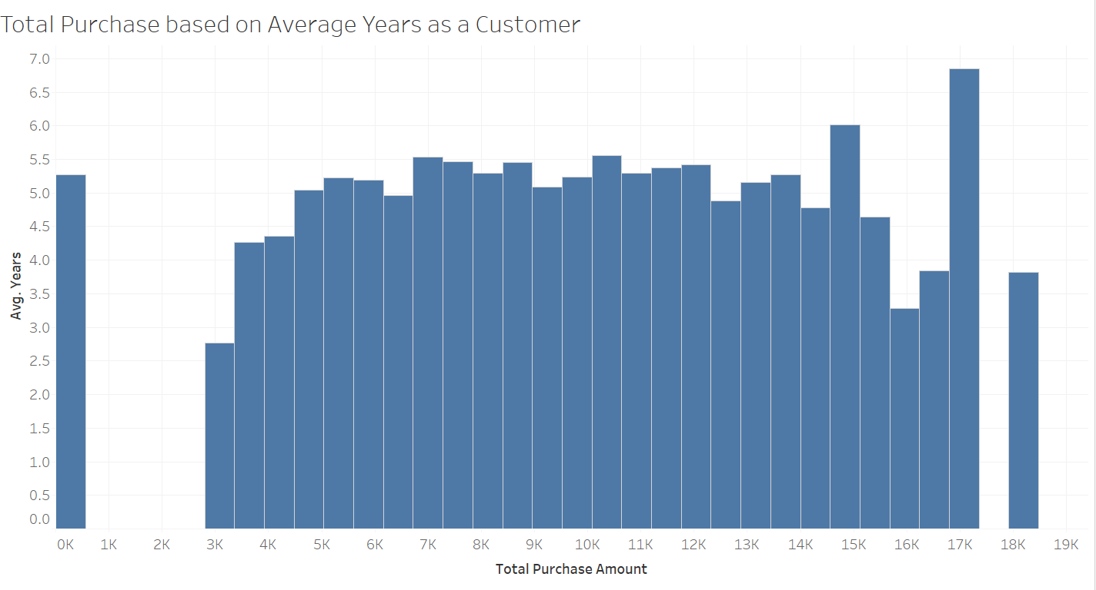

Slide 5
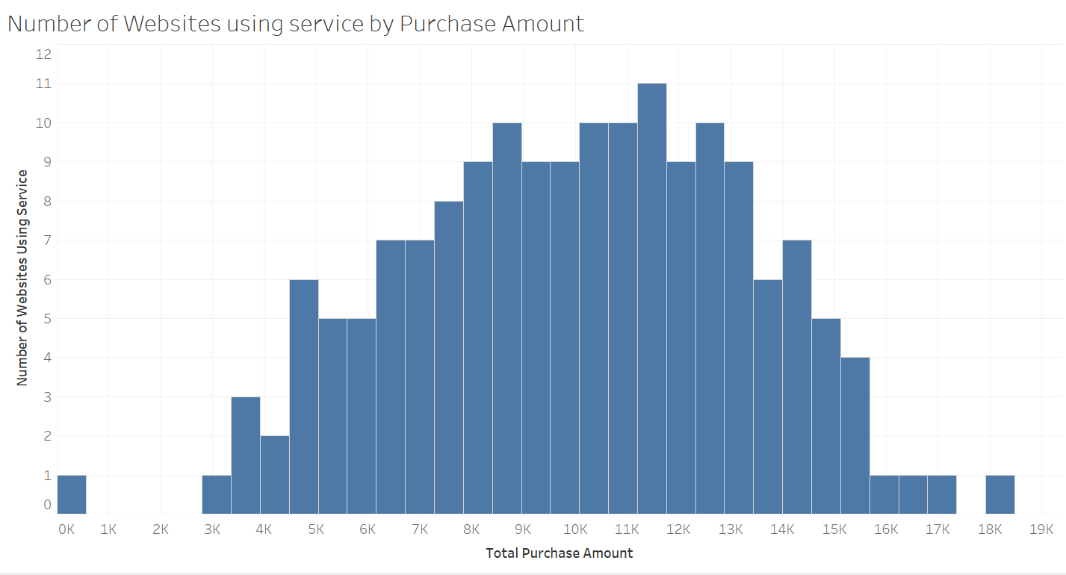

Slide 6
Data Exploration
Tunga

Slide 7
Neural Networks
Francesca

Slide 8
TBD
Max

Slide 9
Challenges Faced

